Slide 1
CHAPTER 3 - Relational Database Modeling
Database Systems -
Introduction to Databases and Data Warehouses

Slide 2
INTRODUCTION
Relational database model - logical database model that represents a database as a collection of related tables
Relational schema - visual depiction of the relational database model
Most contemporary commercial DBMS software packages, are relational DBMS (RDBMS) software packages
Notes:
Once database requirements are collected and visualized as an ER diagram, the next step in creating a relational database is to map (convert) the ER diagram into a relational schema.

Slide 3
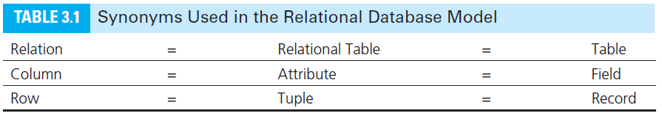
INTRODUCTION
Terminology

Slide 4
INTRODUCTION
Relation - table in a relational database
A table containing rows and columns
The main construct in the relational database model
Every relation is a table, not every table is a relation

Slide 5
INTRODUCTION
Relation - table in a relational database
In order for a table to be a relation the following conditions must hold:
Each column must have a name (within one table, each column name must be unique)
Within one table, each row must be unique
Within each row, each value in each column must be single valued (multiple values of the content represented by the column are not allowed in any rows of the table)
All values in each column must be from the same (predefined) domain
Order of columns is irrelevant
Order of rows is irrelevant

Slide 6
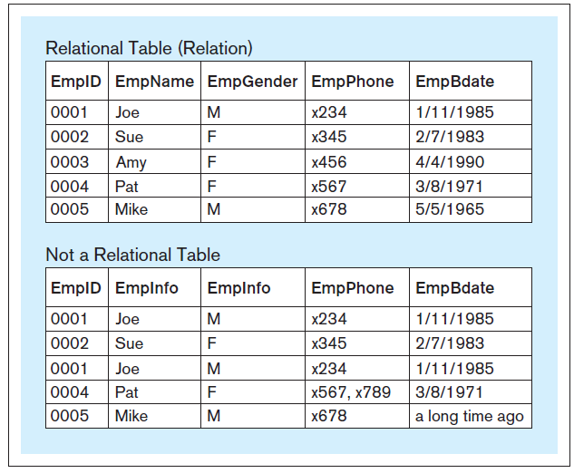
INTRODUCTION
Example of relational and non-relational tables
Notes:
This example is discussed on Page 58.

Slide 7
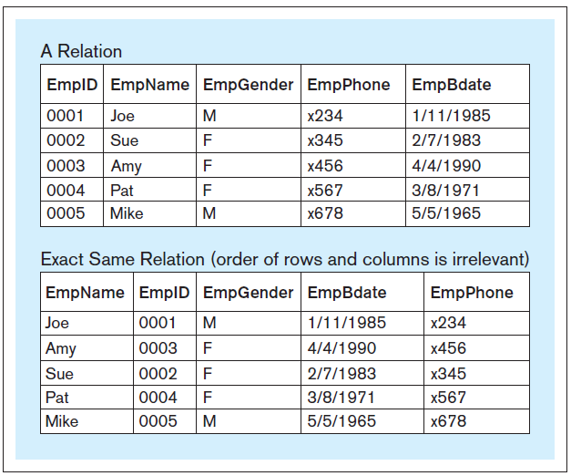
INTRODUCTION
Example of a relation with rows and columns appearing in a different order
Notes:
This example is discussed on Pages 58-59.

Slide 8
INTRODUCTION
Relational database - collection of related relations within which each relation has a unique name

Slide 9
PRIMARY KEY
Primary key - column (or a set of columns) whose value is unique for each row
Each relation must have a primary key
The name of the primary key column is underlined in order to distinguish it from the other columns in the relation

Slide 10
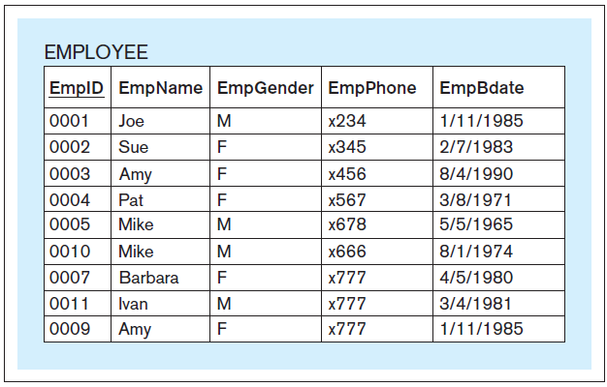
PRIMARY KEY
Relation with the primary key underlined

Slide 11
MAPPING ER DIAGRAMS INTO RELATIONAL SCHEMAS
Once an ER diagram is constructed, it is subsequently mapped into a relational schema (collection of relations)

Slide 12
MAPPING ENTITIES
Mapping entities into relations
Each regular entity becomes a relation
Each regular attribute of a regular entity becomes a column of the newly created relation
If an entity has a single unique attribute, then that attribute becomes the primary key in the resulting mapped relation

Slide 13
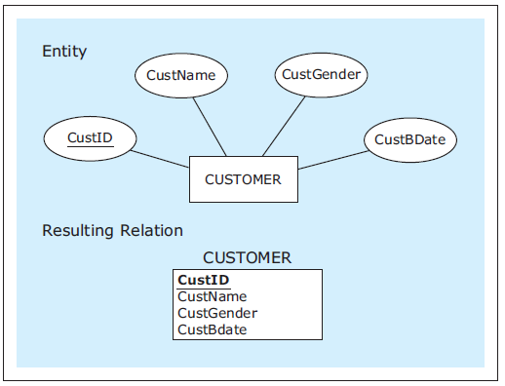
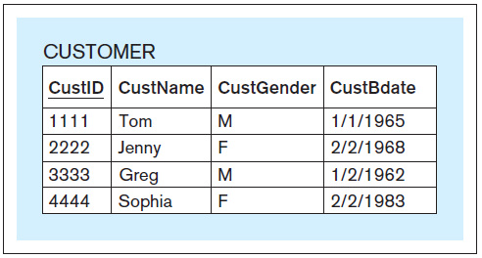
MAPPING ENTITIES
Entity mapped into a relation
Sample data records for the mapped relation
Notes:
This example is discussed on Pages 59-60.

Slide 14
MAPPING ENTITIES WITH COMPOSITE ATTRIBUTES
Mapping entities with composite attributes into relations
Each component of a composite attribute is mapped as a column of a relation
The composite attribute itself does not appear in the mapped relation

Slide 15
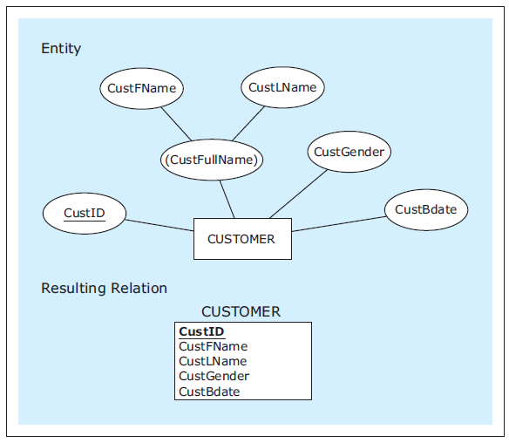
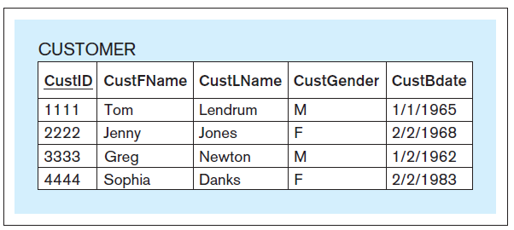
MAPPING ENTITIES WITH COMPOSITE ATTRIBUTES
Entity with a composite attribute mapped into a relation
Sample data records for the mapped relation
Notes:
This example is discussed on Pages 60-61.

Slide 16
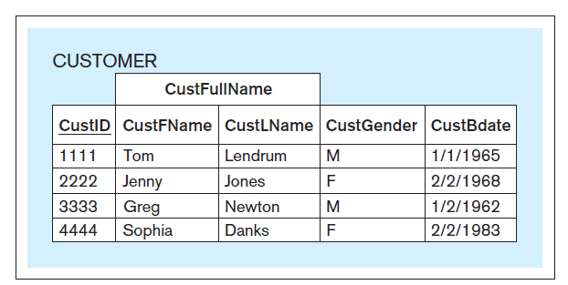
MAPPING ENTITIES WITH COMPOSITE ATTRIBUTES
The mapped relation as presented to a user in a front-end application
Notes:
This example is discussed on Pages 60-61.

Slide 17
COMPOSITE PRIMARY KEY
Composite primary key - a primary key that is composed of multiple columns
Column names of a composite primary key are underlined, because combined together they form the primary key

Slide 18
MAPPING ENTITIES WITH UNIQUE COMPOSITE ATTRIBUTES
Mapping entities with unique composite attributes into relations
An entity whose only unique attribute is a composite attribute is mapped as a relation with a composite primary key

Slide 19
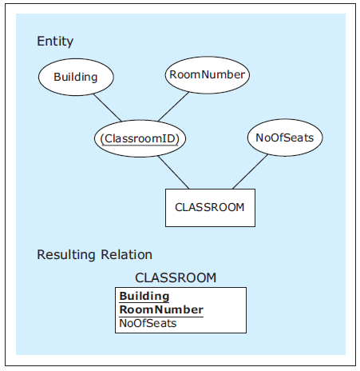
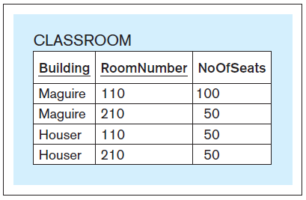
MAPPING ENTITIES WITH UNIQUE COMPOSITE ATTRIBUTES
Entity with a unique composite attribute mapped into a relation
Sample data records for the mapped relation
Notes:
This example is discussed on Page 61.

Slide 20
MAPPING ENTITIES WITH OPTIONAL ATTRIBUTES
Mapping entities with optional attributes into relations
Optional attribute of an entity is mapped as an optional column

Slide 21
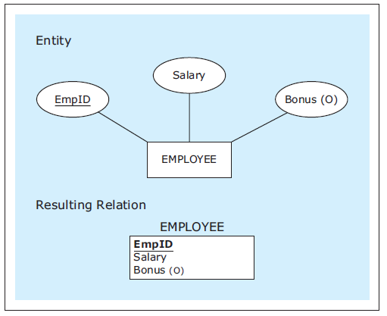
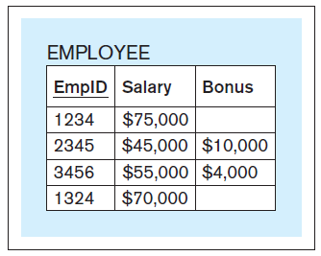
MAPPING ENTITIES WITH OPTIONAL ATTRIBUTES
Entity with an optional attribute mapped into a relation
Sample data records for the mapped relation
Notes:
This example is discussed on Page 62.

Slide 22
ENTITY INTEGRITY CONSTRAINT
Entity integrity constraint - in a relational table, no primary key column can have null (empty) values
A rule stating that no primary key column can be optional
Every RBMS enforces this rule

Slide 23
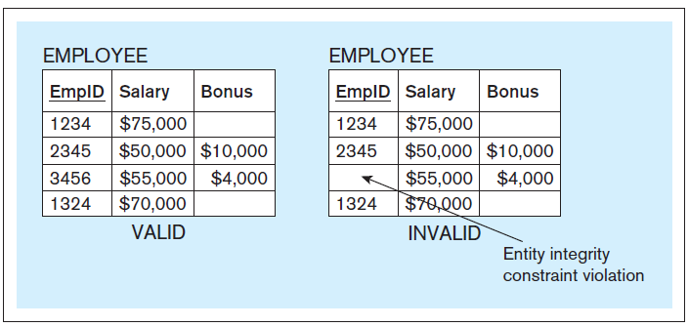
ENTITY INTEGRITY CONSTRAINT
Entity integrity constraint — compliance and violation example
Notes:
This example is discussed on Page 62.

Slide 24
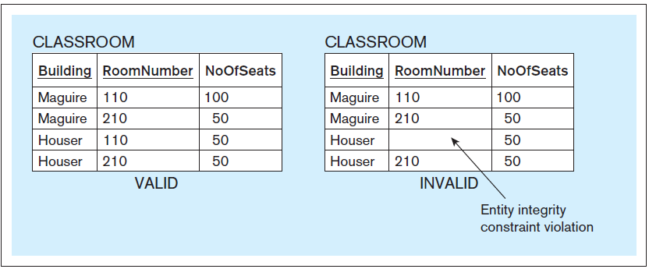
ENTITY INTEGRITY CONSTRAINT
Entity integrity constraint — another compliance and violation example
Notes:
This example is discussed on Page 62.

Slide 25
FOREIGN KEY
Foreign key - column in a relation that refers to a primary key column in another (referred) relation
A mechanism that is used to depict relationships in the relational database model
For every occurrence of a foreign key, the relational schema contains a line pointing from the foreign key to the corresponding primary key

Slide 26
MAPPING RELATIONSHIPS
Mapping 1:M relationships
The relation mapped from the entity on the M side of the 1:M relationship has a foreign key that corresponds to the primary key of the relation mapped from the 1 side of the 1:M relationship.

Slide 27
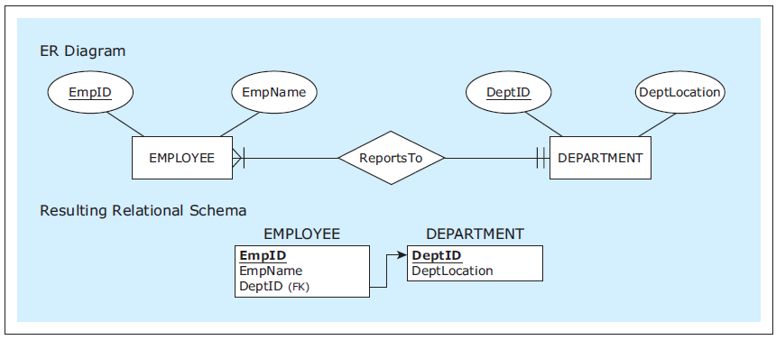
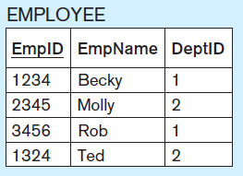
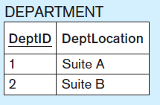
MAPPING RELATIONSHIPS
Example - Mapping a 1:M relationship
Sample data records for the mapped ER diagram
Notes:
This example is discussed on Page 64.

Slide 28
MAPPING RELATIONSHIPS
Example - Mapping a 1:M relationship
Mandatory participation on both sides
Sample data records for the mapped ER diagram
Notes:
This example is discussed on Page 64.

Slide 29
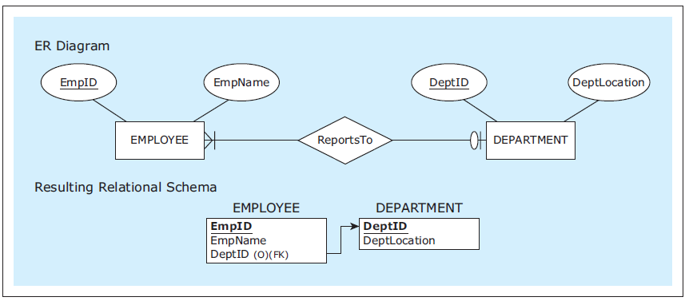
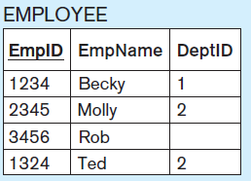
MAPPING RELATIONSHIPS
Example - Mapping a 1:M relationship
Optional participation on the 1 side
Sample data records for the mapped ER diagram
Notes:
This example is discussed on Page 65.

Slide 30
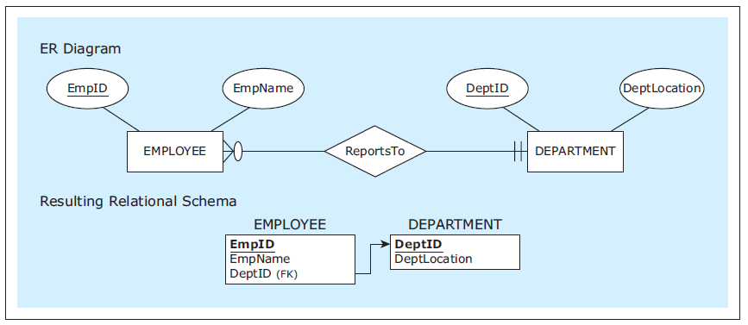
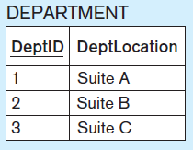
MAPPING RELATIONSHIPS
Example - Mapping a 1:M relationship
Optional participation on the M side
Sample data records for the mapped ER diagram
Notes:
This example is discussed on Page 65.

Slide 31
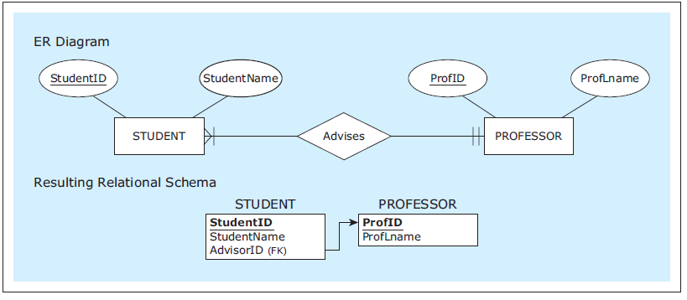
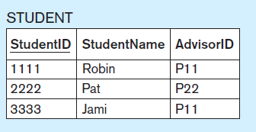
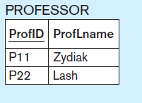
MAPPING RELATIONSHIPS
Example - Mapping a 1:M relationship
Renaming a foreign key
Sample data records for the mapped ER diagram
Notes:
This example is discussed on Page 66.

Slide 32
MAPPING RELATIONSHIPS
Mapping M:N relationships
In addition to the two relations representing the two entities involved in the M:N relationship, another relation is created to represent the M:N relationship itself
This new relation has two foreign keys, corresponding to the primary keys of the two relations representing the two entities involved in the M:N relationship
The two foreign keys form the composite primary key of the new relation

Slide 33
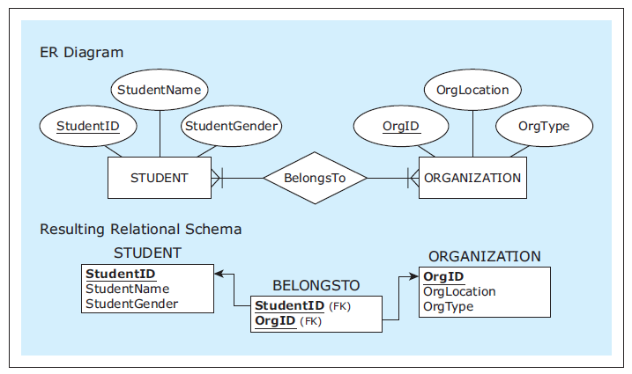
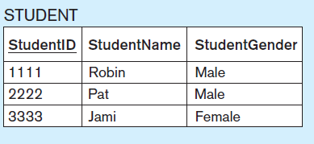
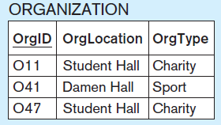
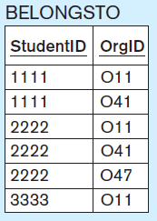
MAPPING RELATIONSHIPS
Example - Mapping an M:N relationship
Sample data records for the mapped ER diagram
Notes:
This example is discussed on Page 66.

Slide 34
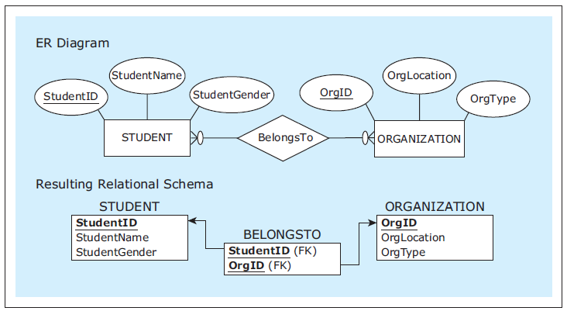
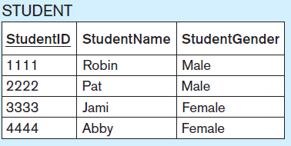
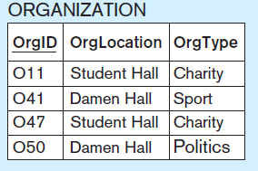
MAPPING RELATIONSHIPS
Example - Mapping an M:N relationship
Optional participation on both sides
Sample data records for the mapped ER diagram
Notes:
This example is discussed on Page 67.

Slide 35
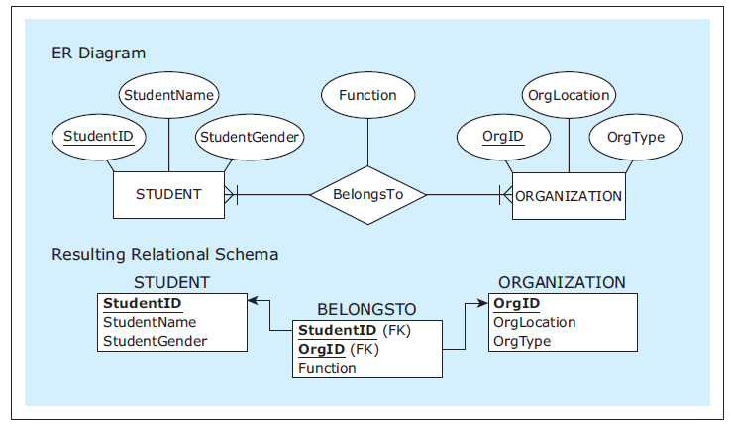
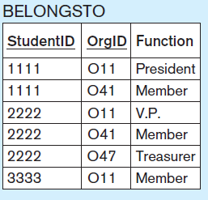
MAPPING RELATIONSHIPS
Example - Mapping a M:N relationship with an attribute
Sample data records for the mapped ER diagram
Notes:
This example is discussed on Pages 67-68.

Slide 36
MAPPING RELATIONSHIPS
Mapping 1:1 relationships
1:1 relationships are mapped in the same way as 1:M relationships
One of the resulting relations will have a foreign key pointing to the primary key of another resulting relation
One of the mapped relations is chosen to have a foreign key referring to the primary key of the other mapped relation
In cases when there is no particular advantage in choosing which resulting relation will include a foreign key, the choice can be arbitrary
In other cases one choice can be more efficient than the other
Notes:
For example, whenever there is a choice between an optional and a mandatory foreign key, choosing the mandatory foreign key is recommended.

Slide 37
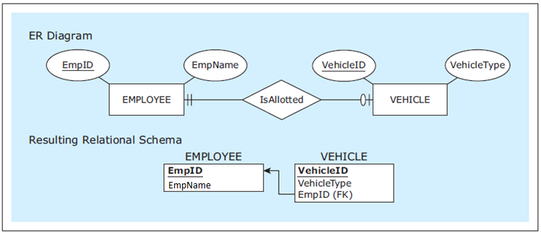

MAPPING RELATIONSHIPS INTO RELATIONAL DATABASE CONSTRUCTS
Example - Mapping a 1:1 relationship
Sample data records for the mapped ER diagram
Notes:
This example is discussed on Page 68.

Slide 38
REFERENTIAL INTEGRITY CONSTRAINT
Referential integrity constraint - In each row of a relation containing a foreign key, the value of the foreign key EITHER matches one of the values in the primary key column of the referred relation OR the value of the foreign key is null (empty).
A rule that defines values that are valid for use in foreign keys
In a relational schema lines pointing from the foreign key to the corresponding primary key are referred to as referential integrity constraint lines

Slide 39
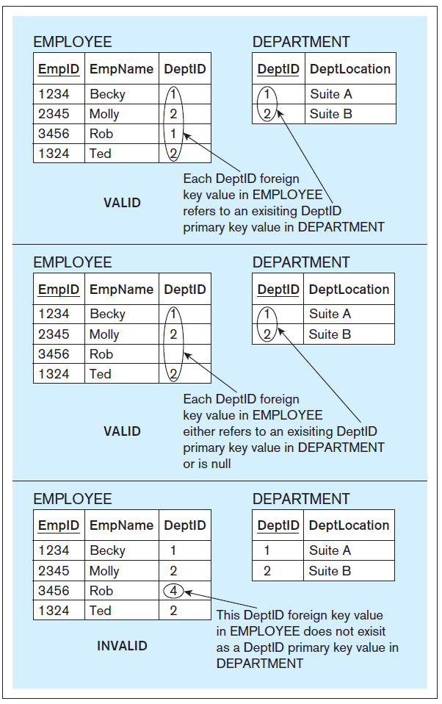
REFERENTIAL INTEGRITY CONSTRAINT
Referential integrity constraint — compliance and violation examples
Notes:
This example is discussed on Page 62.

Slide 40
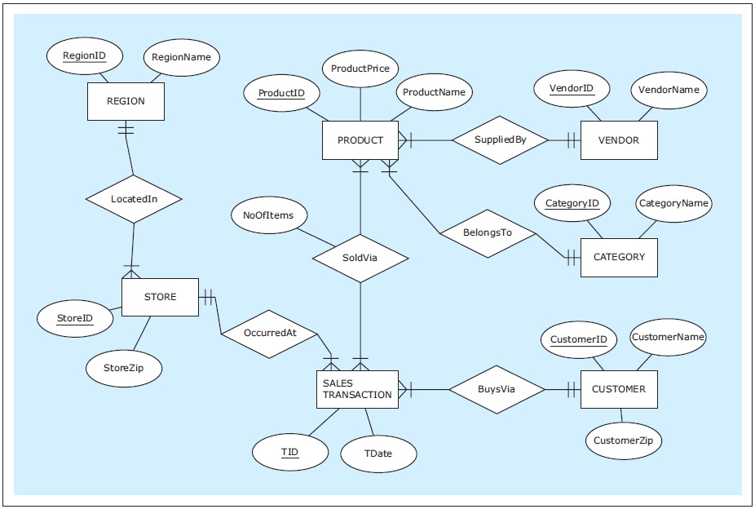
Example ER diagram : ZAGI Retail Company Sales Department Database
Notes:
This example is discussed on Page 70.

Slide 41
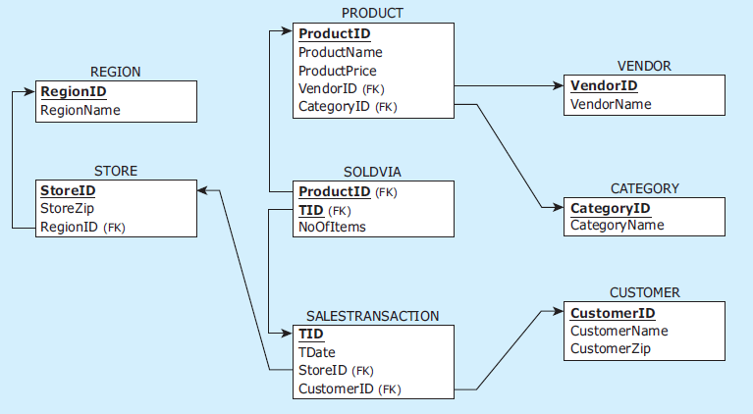
Example mapped relational schema: ZAGI Retail Company Sales Department Database
Notes:
This example is discussed on Page 70.

Slide 42
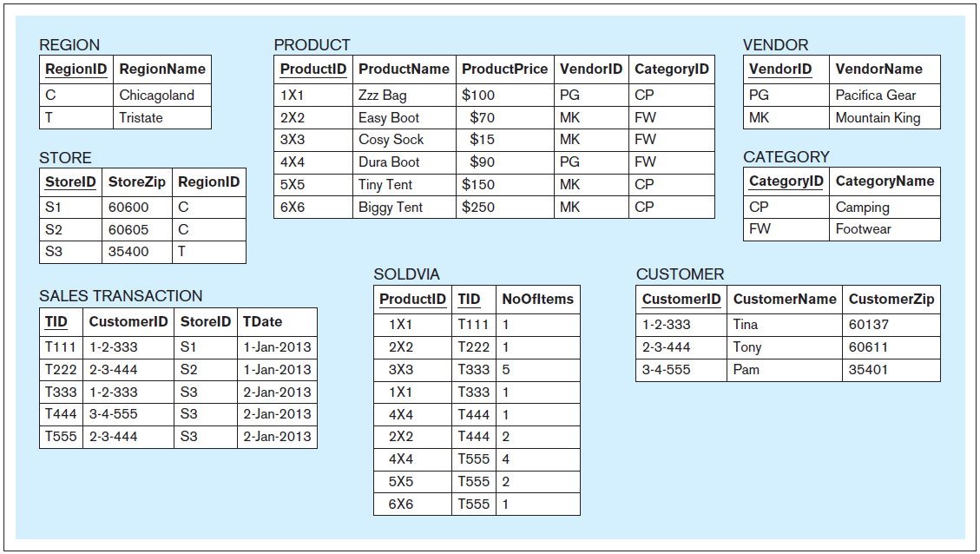
Example: Sample data records for the ZAGI Retail Company Sales Department Database
Notes:
This example is discussed on Page 70.

Slide 43
MAPPING CANDIDATE KEYS
Mapping entities with candidate keys (multiple unique attributes) into relations
One of the candidate keys is chosen by database designer the as a primary key during the mapping process
Other candidate keys are mapped as non-primary key columns
Notes:
An entity can have more than one unique attribute. In such cases each unique attribute is also called a candidate key.

Slide 44
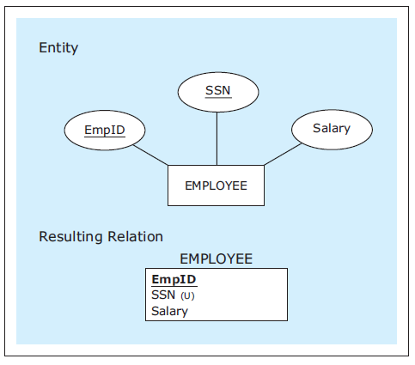
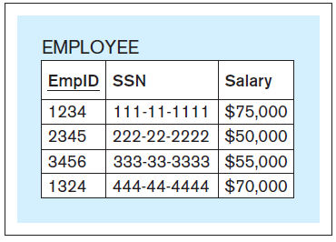
MAPPING ENTITIES WITH CANDIDATE KEYS (MULTIPLE UNIQUE ATTRIBUTES) INTO RELATIONS
Entity with candidate keys mapped into a relation
Sample data records for the mapped relation
Notes:
This example is discussed on Page 71.

Slide 45
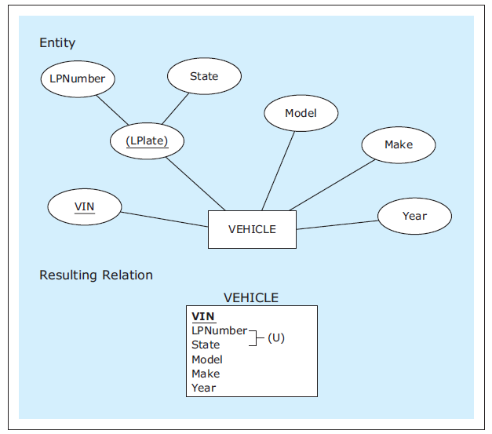
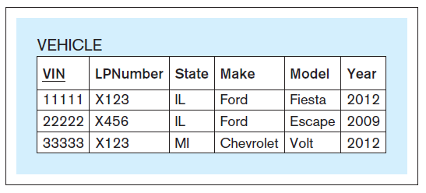
MAPPING CANDIDATE KEYS
Entity with regular and composite candidate keys mapped into a relation
Sample data records for the mapped relation
Notes:
This example is discussed on Page 72.

Slide 46
MAPPING MULTIVALUED ATTRIBUTES
Mapping entities with multivalued attributes into relational database constructs
An entity containing the multivalued attribute is mapped without the multi-valued attribute
The multi-valued attribute is mapped as a separate relation that has a column representing the multivalued attribute and a foreign key column referring to the primary key of the relation resulting from the entity itself
Both of these columns form a composite primary key for the separate relation

Slide 47
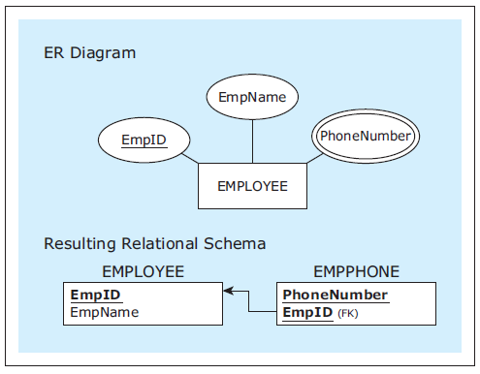
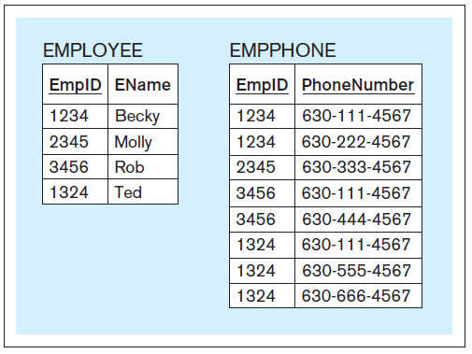
MAPPING MULTIVALUED ATTRIBUTES
Entity with multivalued attributes mapped into relations
Sample data records for the mapped relations
Notes:
This example is discussed on Page 72.

Slide 48
MAPPING DERIVED ATTRIBUTES
Mapping derived attributes
Derived attributes are not mapped as a part of the relational schema
They are implemented as a part of the database front-end application

Slide 49
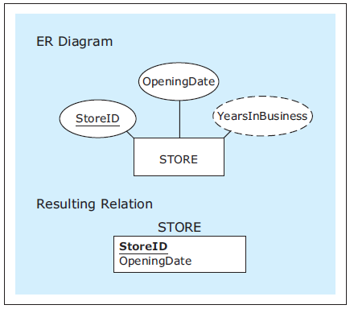
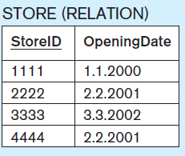
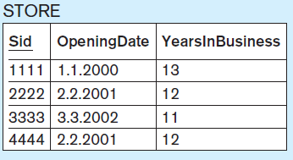
MAPPING DERIVED ATTRIBUTES
Entity with derived attributes mapped into a relation
Sample data records for the mapped relation
The relation shown as presented to a user in a front-end application
Notes:
This example is discussed on Page 73.

Slide 50
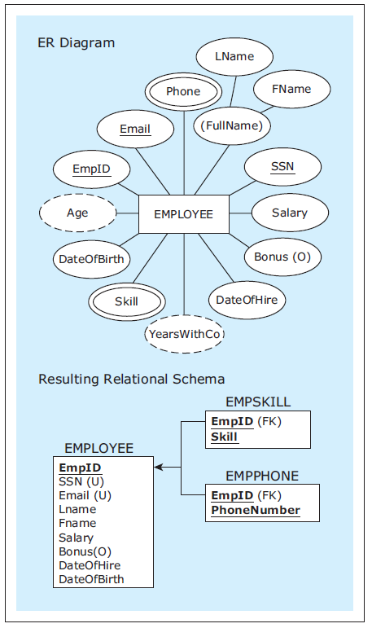
Example : Entity with various types of attributes mapped into a relation
Notes:
This example is discussed on Page 74.

Slide 51
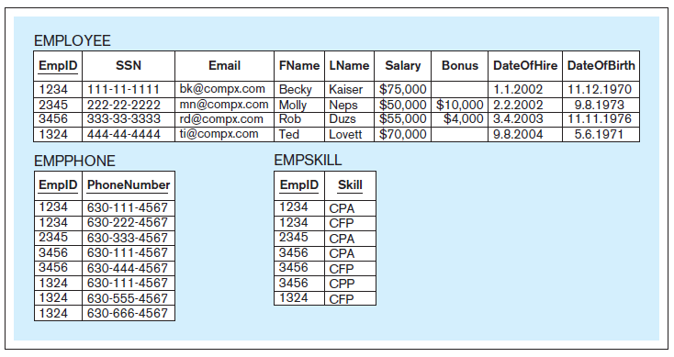
Example : Sample data records for the mapped relations
Notes:
This example is discussed on Page 74.

Slide 52
MAPPING UNARY RELATIONSHIPS
Mapping unary relationships
Unary relationships in ER diagrams are mapped in the same way as binary relationships

Slide 53
MAPPING UNARY RELATIONSHIPS
Mapping 1:M unary relationships
The relation mapped from an entity involved in a 1:M unary relationship contains a foreign key that corresponds to its own primary key

Slide 54


MAPPING UNARY RELATIONSHIPS
Mapping a 1:M unary relationship
Sample data records for the mapped relation
Notes:
This example is discussed on Page 74.

Slide 55
MAPPING UNARY RELATIONSHIPS
Mapping M:N unary relationships
In addition to the relation representing the entity involved in a unary M:N relationship, another relation is created to represent the M:N relationship itself
This new relation has two foreign keys, both of them corresponding to the primary key of the relation representing the entity involved in the unary M:N relationship
Each of the foreign keys is used as a part of the composite primary key of the new relation

Slide 56



MAPPING UNARY RELATIONSHIPS
Mapping a M:N unary relationship
Sample data records for the mapped relations
Notes:
This example is discussed on Page 75.

Slide 57
MAPPING UNARY RELATIONSHIPS
Mapping 1:1 unary relationships
Mapped in the same way as 1:M unary relationships

Slide 58


MAPPING UNARY RELATIONSHIPS
Mapping a 1:1 unary relationship
Sample data records for the mapped relation
Notes:
This example is discussed on Page 76.

Slide 59
MAPPING MULTIPLE RELATIONSHIPS BETWEEN THE SAME ENTITIES
Mapping multiple relationships between the same entities
Each relationship is mapped
Notes:
It not unusual for the same entities in an ER diagram to be related via more than one relationship.

Slide 60


MAPPING MULTIPLE RELATIONSHIPS BETWEEN THE SAME ENTITIES
Mapping multiple relationships between the same entities
Sample data records for the mapped relations
Notes:
This example is discussed on Page 76.

Slide 61
MAPPING WEAK ENTITIES
Mapping weak entities
Weak entities are mapped in a same way as regular entities with one addition:
The resulting relation has a composite primary key that is composed of the partial identifier and the foreign key corresponding to the primary key of the owner entity

Slide 62



MAPPING WEAK ENTITIES
Mapping a weak entity
Sample data records for the mapped relations
Notes:
This example is discussed on Page 77.

Slide 63




MAPPING WEAK ENTITIES
Mapping a weak entity with two owners
Sample data records for the mapped relations
Notes:
This example is discussed on Page 77.

Slide 64


MAPPING WEAK ENTITIES
Mapping a weak entity with no partial identifier
Sample data records for the mapped relations
Notes:
This example is discussed on Page 78.

Slide 65

Example ER diagram : HAFH Realty Company Property Management Database
Notes:
This example is discussed on Page 78.

Slide 66

Example mapped relational schema: HAFH Realty Company Property Management Database
Notes:
This example is discussed on Page 78.

Slide 67

Example: Sample data records for the HAFH Realty Company Property Management Database (part 1)
Notes:
This example is discussed on Page 78.

Slide 68

Example: Sample data records for the HAFH Realty Company Property Management Database (part 2)
Notes:
This example is discussed on Page 78.

Slide 69
RELATIONAL DATABASE CONSTRAINTS
Relational database constraints - rules that a relational database has to satisfy in order to be valid
Implicit constraints
The implicit relational database model rules that a relational database must satisfy in order to be valid
User-defined constraints
Database constraints that are added by the database designer

Slide 70
RELATIONAL DATABASE CONSTRAINTS
Implicit constraints
Each relation in a relational schema must have a different name
Each relation must satisfy the following conditions:
Each column must have a different name
Each row must be unique
In each row, each value in each column must be single valued
Domain constraint - all values in each column must be from the same predefined domain
The order of columns is irrelevant
The order of rows is irrelevant
Primary key constraint - each relation must have a primary key, which is a column (or a set of columns) whose value is unique for each row
Entity integrity constraint
Referential integrity constraint

Slide 71
RELATIONAL DATABASE CONSTRAINTS
User-defined constraints
Added by the database designers

Slide 72



RELATIONAL DATABASE CONSTRAINTS
Specific minimum and maximum cardinalities
Sample data records for the mapped relations
Notes:
This example is discussed on Page 81.

Slide 73
RELATIONAL DATABASE CONSTRAINTS
Business rules
User defined constraints that specify restrictions on databases that are not a part of the standard notation for creating ER diagrams

Slide 74


RELATIONAL DATABASE CONSTRAINTS
Business rule for salary amounts
Sample data records for the mapped relation
Notes:
This example is discussed on Pages 81-82.

Slide 75


RELATIONAL DATABASE CONSTRAINTS
Business rule for the dates of enrollment and graduation
Sample data records for the mapped relation
Notes:
This example is discussed on Page 82.

Slide 76




RELATIONAL DATABASE CONSTRAINTS
Business rule for gender of students in an organization
Sample data records for the mapped relation
Notes:
This example is discussed on Page 82.

